Slide 1
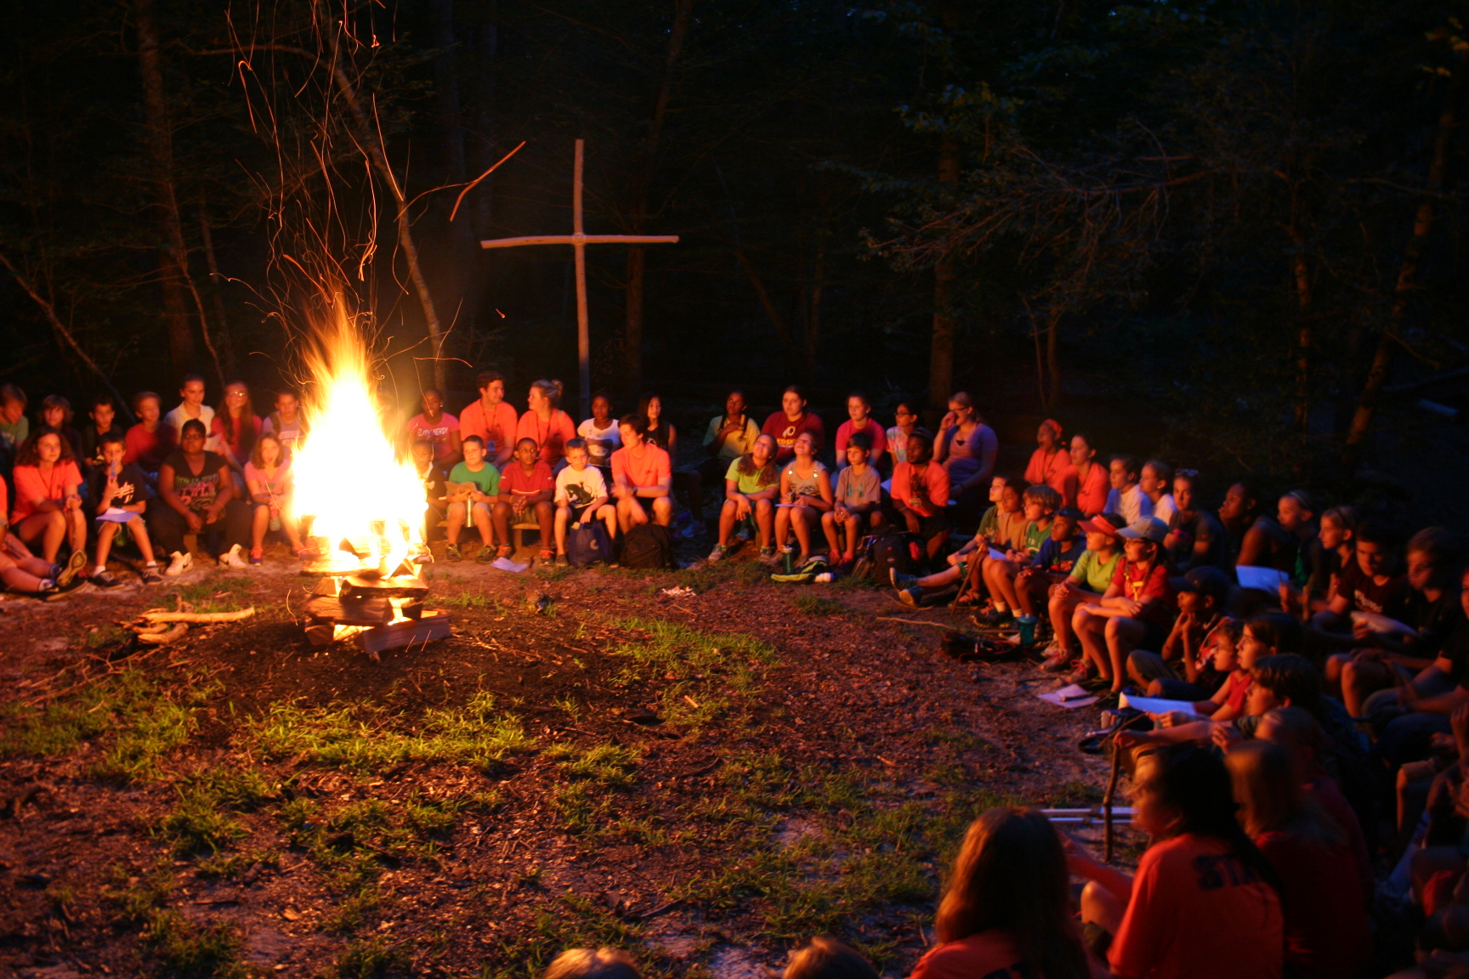
Mechanicsville, VA
Learn More About 2021 Summer Camps
www.camphanover.org/summer-camp

