Slide 1
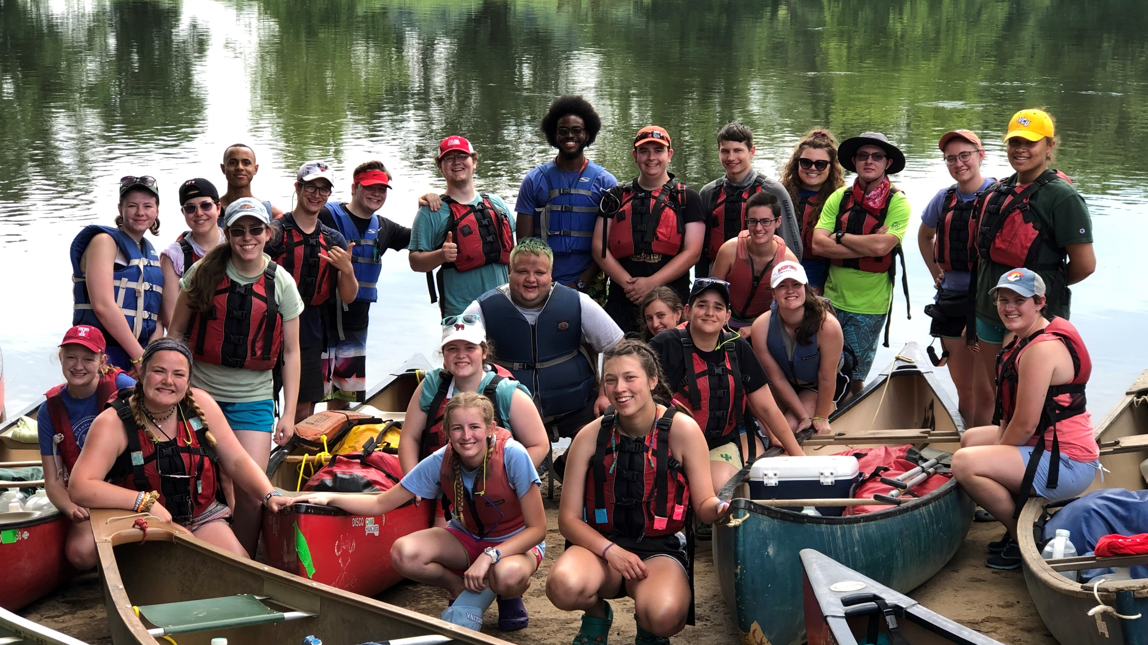

BEST. SUMMER. JOB. EVER.
camphanover.org/work-at-camp

