Slide 1
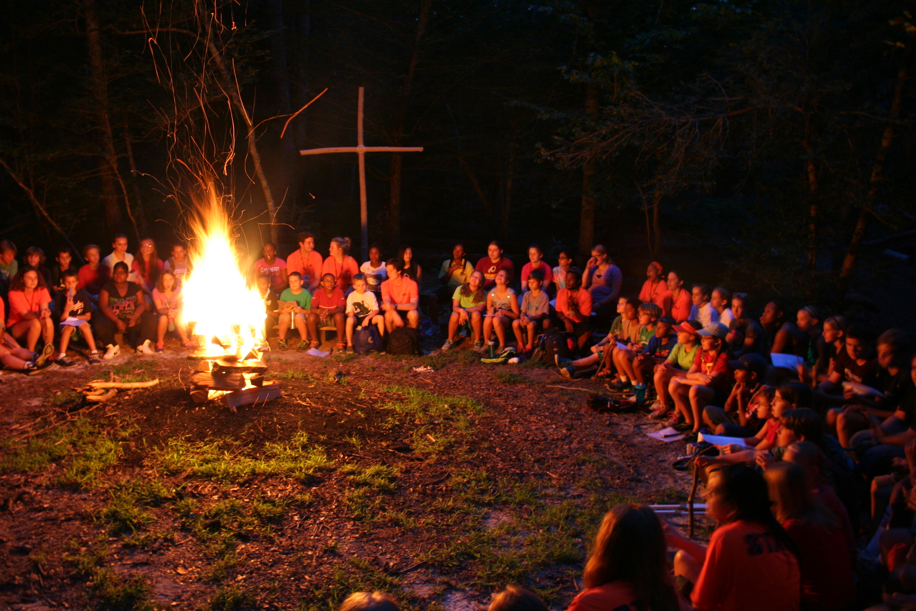
Mechanicsville, VA
Learn More About Summer Camps
www.camphanover.org/summer-camp

Slide 2
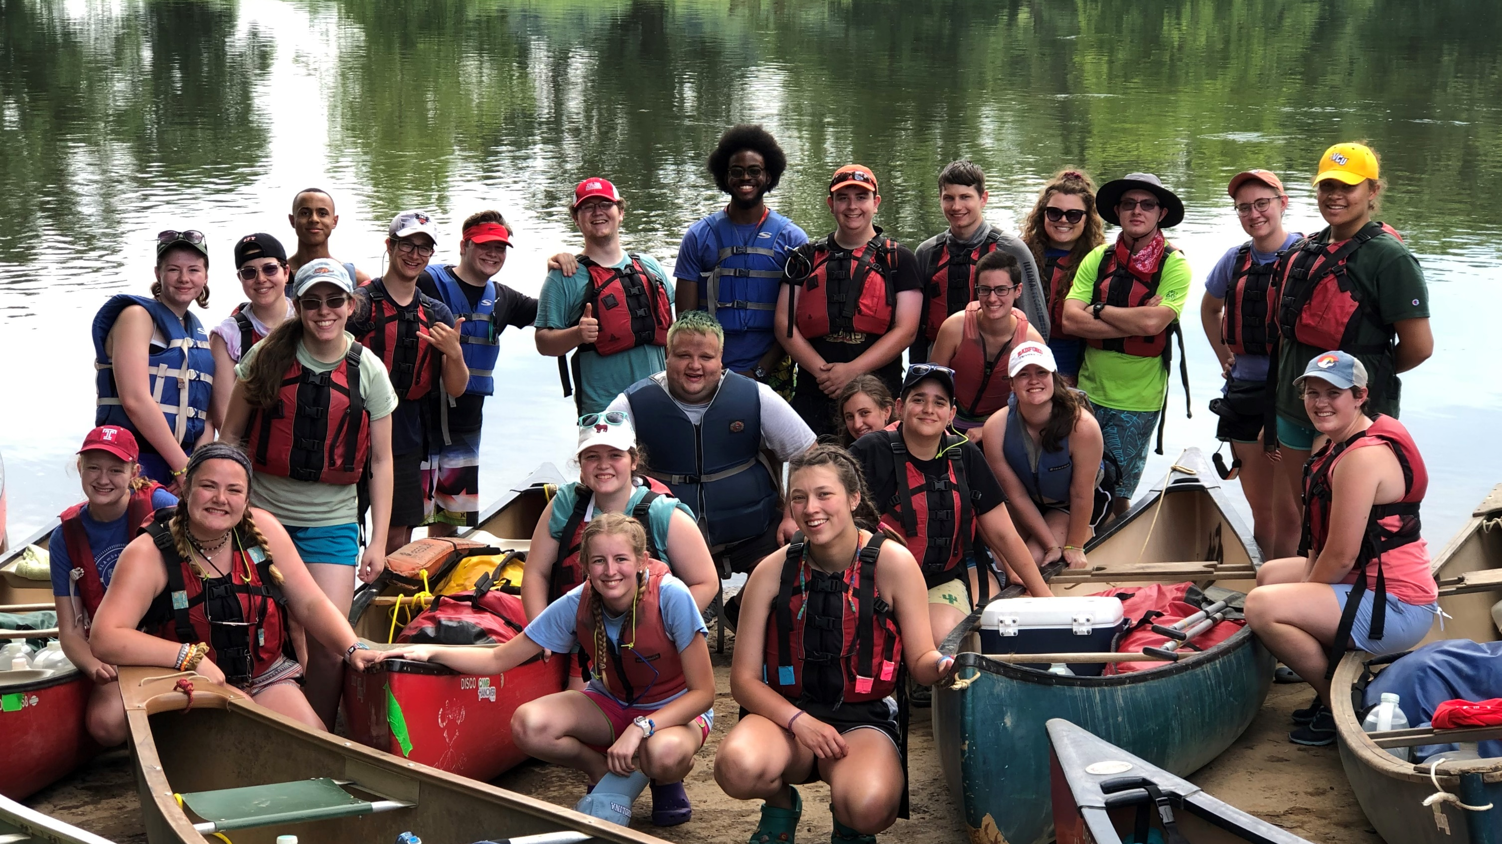
BEST. SUMMER. JOB. EVER.
camphanover.org/work-at-camp

